Slide 1
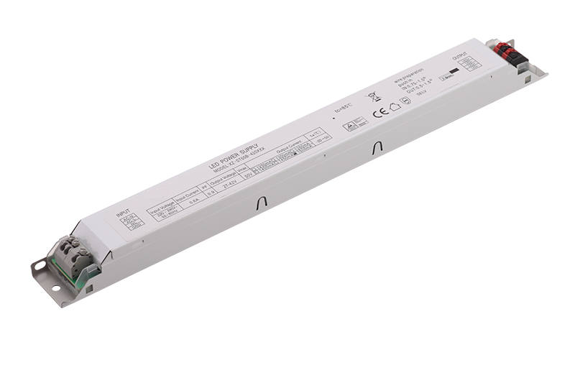
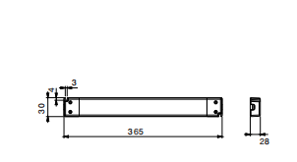
LED Power Supply
YSL100B SERIES
Input: 100-240VAC/200-240V 50-60Hz
Output Voltage: 12V,24V,36V, 48V
Rated Power: 100W max
Features
- Universal Input: 100-240V/200-240V AC 50-60Hz
- RoHS Compliance
- EMI Standard EN55015
- Safety Standard: EN61347-1, EN61347-2-13, UL8750
- Inrush current<65A AC230V/50Hz
- High efficiency & low power consumption
- Short Circuit, Over Current and Over
Voltage Protection
- Over temperature protection
- 100% full load burn-in test
Application
LED lights bring
LED indoor lighting
LED decorative lighting
LED building lighting
Dimensions and Installation

Slide 2
LED Power Supply
YSL100B SERIES
MODEL DETAIL SPEC. |  | YSL100B-1208300 | YSL100B-2404160 | YSL100B-3602700 |  | YSL100B-4802080
INPUT | Input Voltage: | 100-240VAC/ 200-240VAC
 | Input Frequency: | 50-60Hz
 | Inrush Current: | 65 Amps max. at 230VAC/50Hz,full load
 | AC Current: | 0.56A/230VAC
 | Leakage Current: | ＜0.35mA/240VAC
 | Efficiency: | 89% | 89% | 89% |  | 89%
OUTPUT | DC Voltage: | 12V | 24V | 36V |  | 48V
 | Rated Current: | 8300mA | 4160mA | 2700mA |  | 2080mA
 | Rated Power: | 100W | 100W | 100W |  | 100W
 | Voltage Tolerance: | ±5.0% | ±5.0% | ±5.0% |  | ±5.0%
 | Ripple and Noise: | 120mVp-p | 240mVp-p | 360mVp-p | 480mVp-p
 | Line Regulation: | ±3%
 | Load Regulation: | ±5%
 | Setup, Rise, Hold Up time: | 1s, 10ms/60ms 230VAC 1000ms, 1ms/25ms 115VAC at full load
ENVIRONMENTAL | Operating Temperature: | -20 ~ +50 (Refer to "Derating Curve")
 | Storage Temp: | -40℃ ~ 85℃
 | Storage Humidity: | 20 ~ 95% RH
 | Working Humidity: | 20 ~ 95% RH non-condensing
PROTECTION | Over Load: | Above 105%-130% rated output power
 |  | Protection type: Hiccup mode, recovers automatically after fault condition is removed
 | Over Voltage: | 12V:13.8 ~ 16.2V 24V:27.6 ~ 32.4V 36V:41.4~48.6V 48V：55.2~64.8V
 |  | Protection type: Shut down o/p voltage, re-power on to recover
 | Over Temperature: | Shut down o/p voltage, re-power on to recover
SAFETY & EMC | Safety Regulations: | EN61347-2-13:2014+A1:2017,EN61347-1:2015;EN62493:2015
 | Withstand Voltage: | I/P-O/P:3750KVAC
 | Harmonic | EN61000-3-2 Class C EN61000-3-3
 | EMI: | Compliance to EN55015
 | EMS： | compliance to 61547:2009
OTHER | MTBF: | 200,000 Hours Minimum at Full Load at 25℃ Ambient
 | Size: | 365*30*28mm
 | Weight: | 320g / pcs
 | Packaging: | 100PCS/CTN,37.5*28.5*24cm

Slide 3
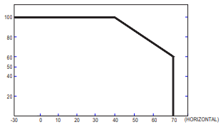
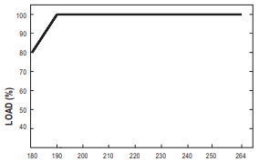
LED Power Supply
YSL100B SERIES
Deduction curve
and temperature
Minus output
and input voltage curves
Load (%)
Load (%)
Environment temperature(℃)
Input voltage(VAC)
Functional Diagram

